Slide 1

Field Usability Study

Slide 2

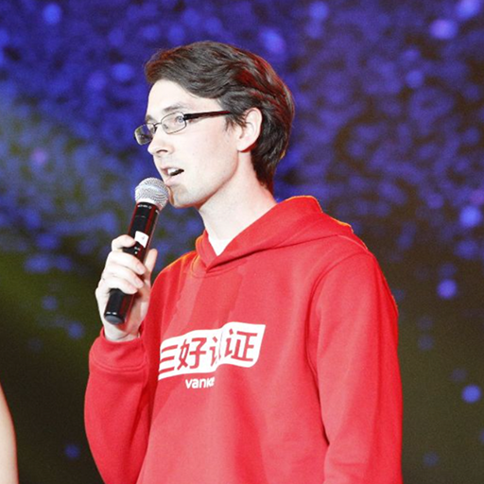
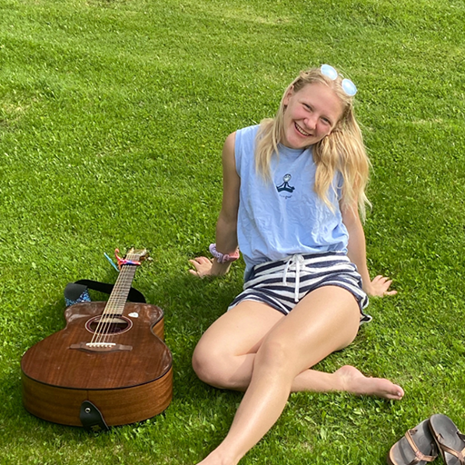
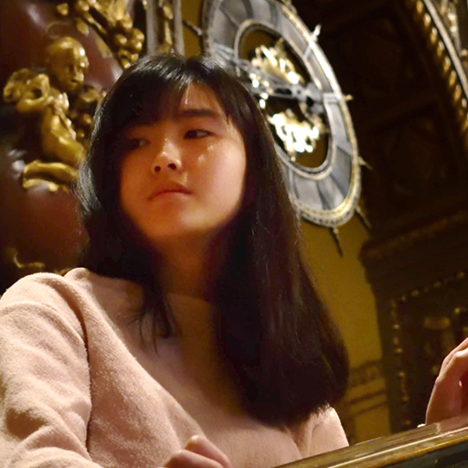
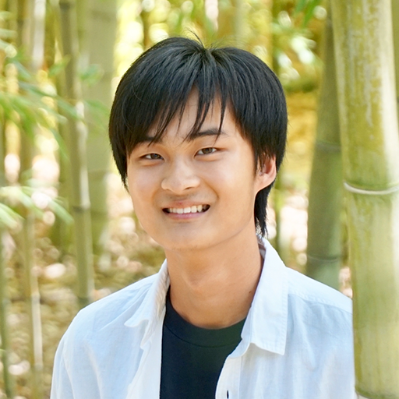
Our Team
Casey N.
Full-stack Developer
Brent J.
Designer Developer PM
Emily R.
Designer PM
Gray W.
Designer Developer
Tristan W.
Designer Developer

Slide 3
Outline
01
Problem, Solution, & Value Prop
02
Participants & Environment
03
Tasks & Procedure
04
Results & Discussion

Slide 4
01
Introduction

Slide 5

Storytime
Volume 1

Slide 6
Problem
Music is inherently social.
But, music streaming platforms today lack engaging social features amidst their amazing access to diverse music

Slide 7
Solution
We want to help people foster relationships through music.

Slide 8


Solution
We want to help people foster relationships through music.
Users can leave music boxes at places as gifts for friends.
Users can explore what their community is listening to geographically.

Slide 9
Testing Our Value Proposition
We offer a social music-sharing mobile app where users can:
🎁 Gift songs
😲 Receive songs as gifts by surprise or in real-time
📍 Discover playlists at their pinned locations
🗺️ Tune in to the music of community members nearby and around the world. (re-prioritized to V3!)
Notes:
Introduction
___ clear what the system is for?
___ valid reasons for running an experiment?

Slide 10
02
Participants & Environment

Slide 11
Participants:
Participation criteria: Music lovers in variety of locations
Compensation: $15 Amazon gift card
Notes:
Participants - who they are (demographics) and how were they recruited & compensated

Slide 12
Participants:
NINA, 24
Data Analyst
Environmental Sciences and Econ grad student @ UC Berkeley
Recruited through Reddit
📍Dorm lounge
(Not Compensated)
LUCAS, 21
AGPM / Education Undergrad @ UCSC
📍Old Union
KARL, 21
CS Undergrad @ Stanford
Asian, avid music logger (last.fm)
Recruited through interest in UX research
📍Library
SHELLEY, 70
Retired Teacher
Master’s in Education
Recruited through network
📍At home
(Not compensated)
JOSH, 22
Biotech founder
Musical theatre star and avid music listener/sharer
📍At home
(Not compensated)
Notes:
Participants - who they are (demographics) and how were they recruited & compensated

Slide 13

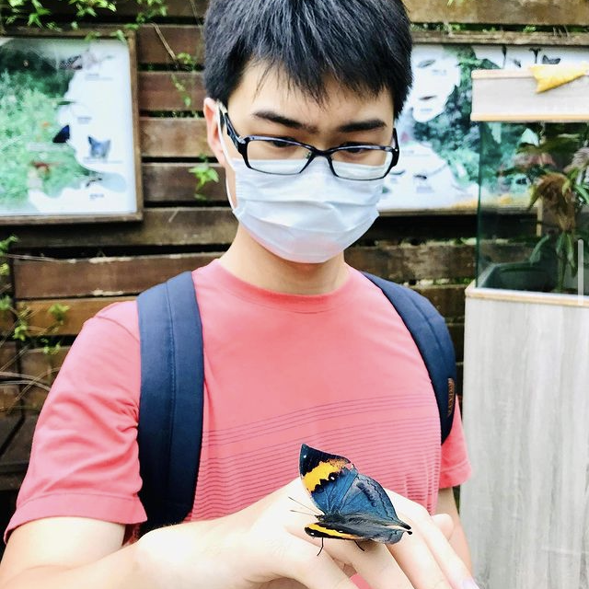
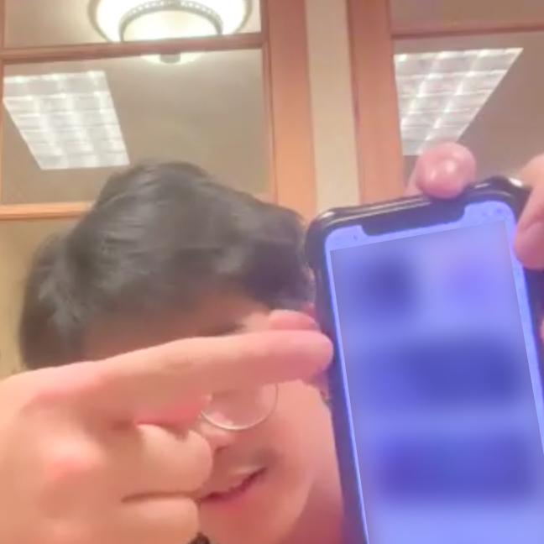
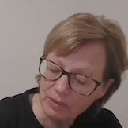
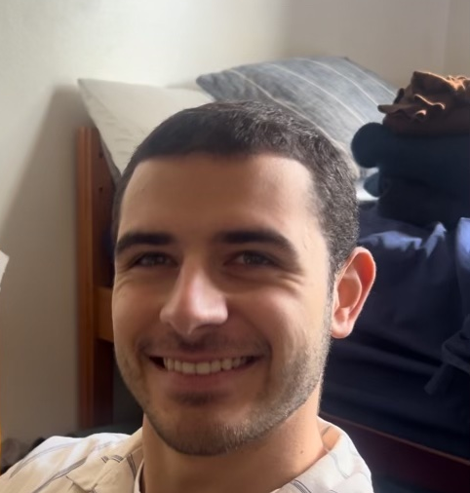
Participants:
“NINA”
(did not share photos)
LUCAS
(not photographed during session)
KARL
SHELLEY
JOSH
Notes:
PHOTOS OF PARTICIPANTS IN NATURAL

Slide 14
03
Tasks & Procedure

Slide 15
Tasks:
Task #1
Accept a musicbox from a friend
Task #2
Discover a playlist at a location (eg. Sigma Nu)
Task #3
Send a musicbox to a friend
Notes:
Tasks - describe each task & what you looked for during each
Tasks & prototype
___ good range?
___ clear on what you were looking for?
___ prototype implemented sufficiently to test?

Slide 16
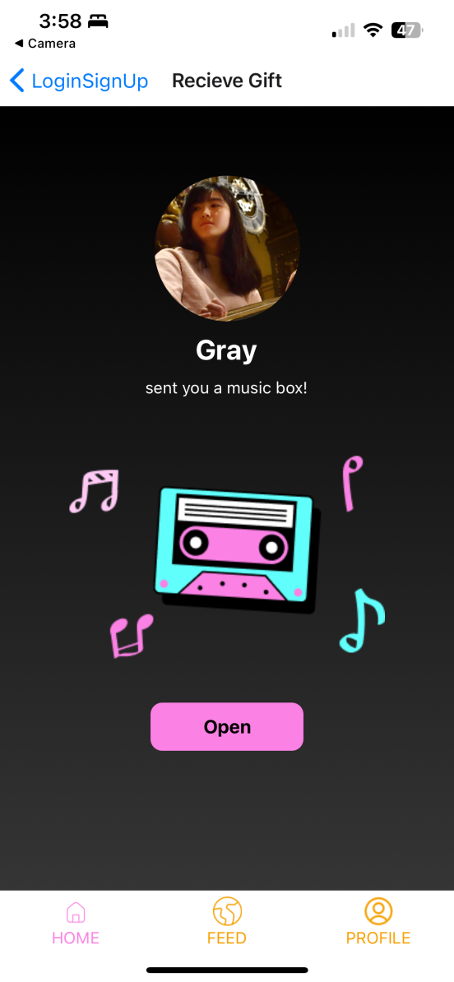
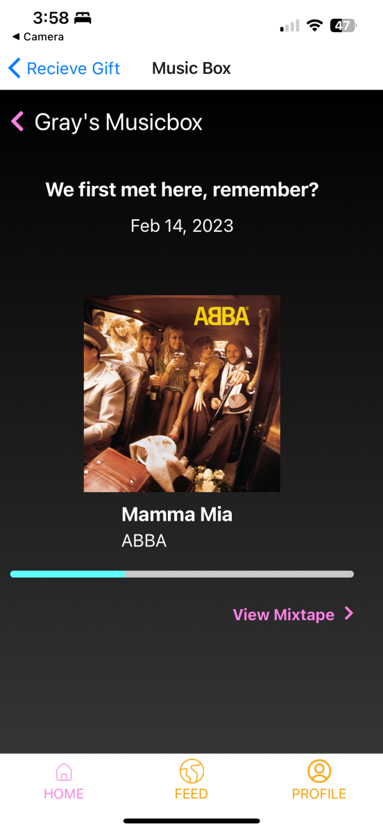
Task 1: Accept a music box
Notes:
Tasks - describe each task & what you looked for during each
Tasks & prototype
___ good range?
___ clear on what you were looking for?
___ prototype implemented sufficiently to test?

Slide 17
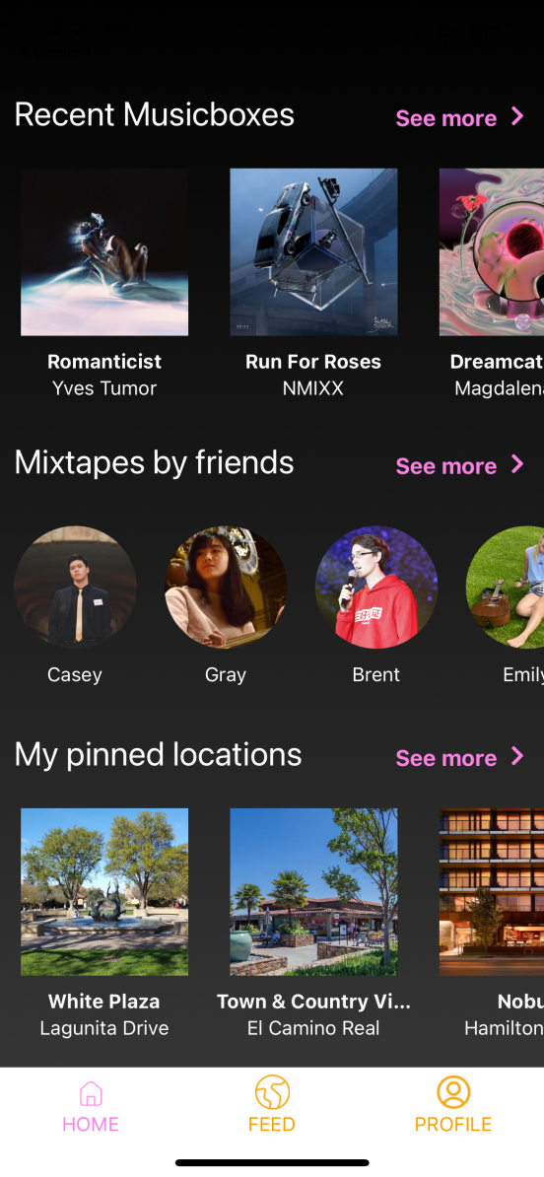
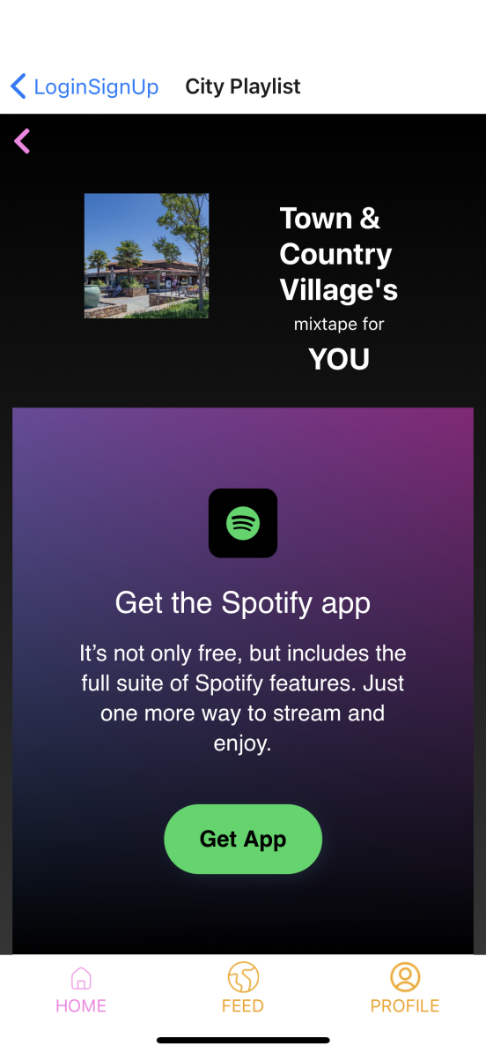
Task 2: Discover a playlist
Notes:
Tasks - describe each task & what you looked for during each
Tasks & prototype
___ good range?
___ clear on what you were looking for?
___ prototype implemented sufficiently to test?

Slide 18
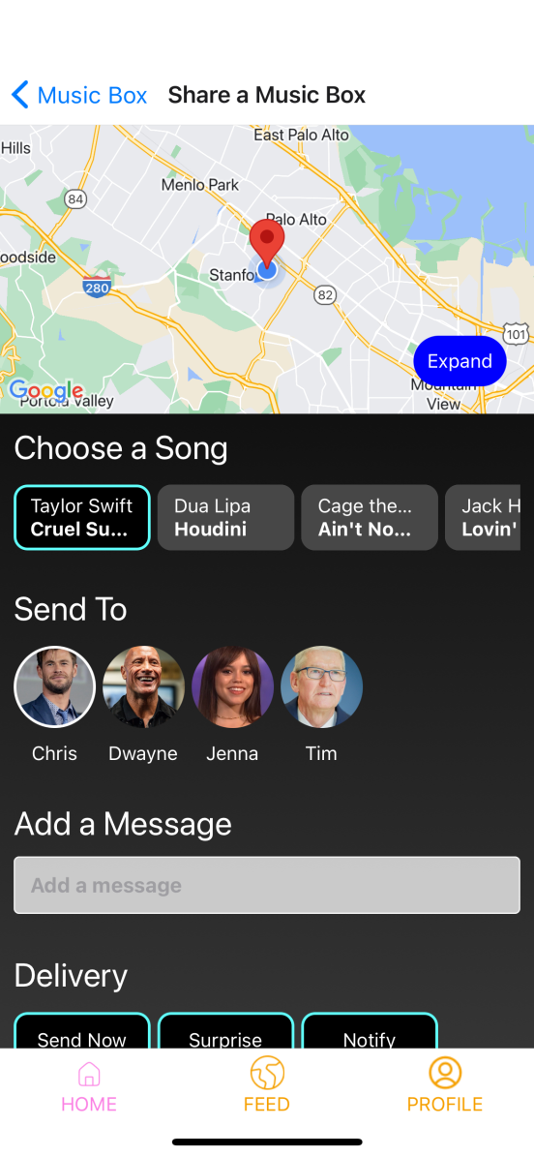
Task 3: Gift a musicbox
Notes:
Tasks - describe each task & what you looked for during each
Tasks & prototype
___ good range?
___ clear on what you were looking for?
___ prototype implemented sufficiently to test?

Slide 19
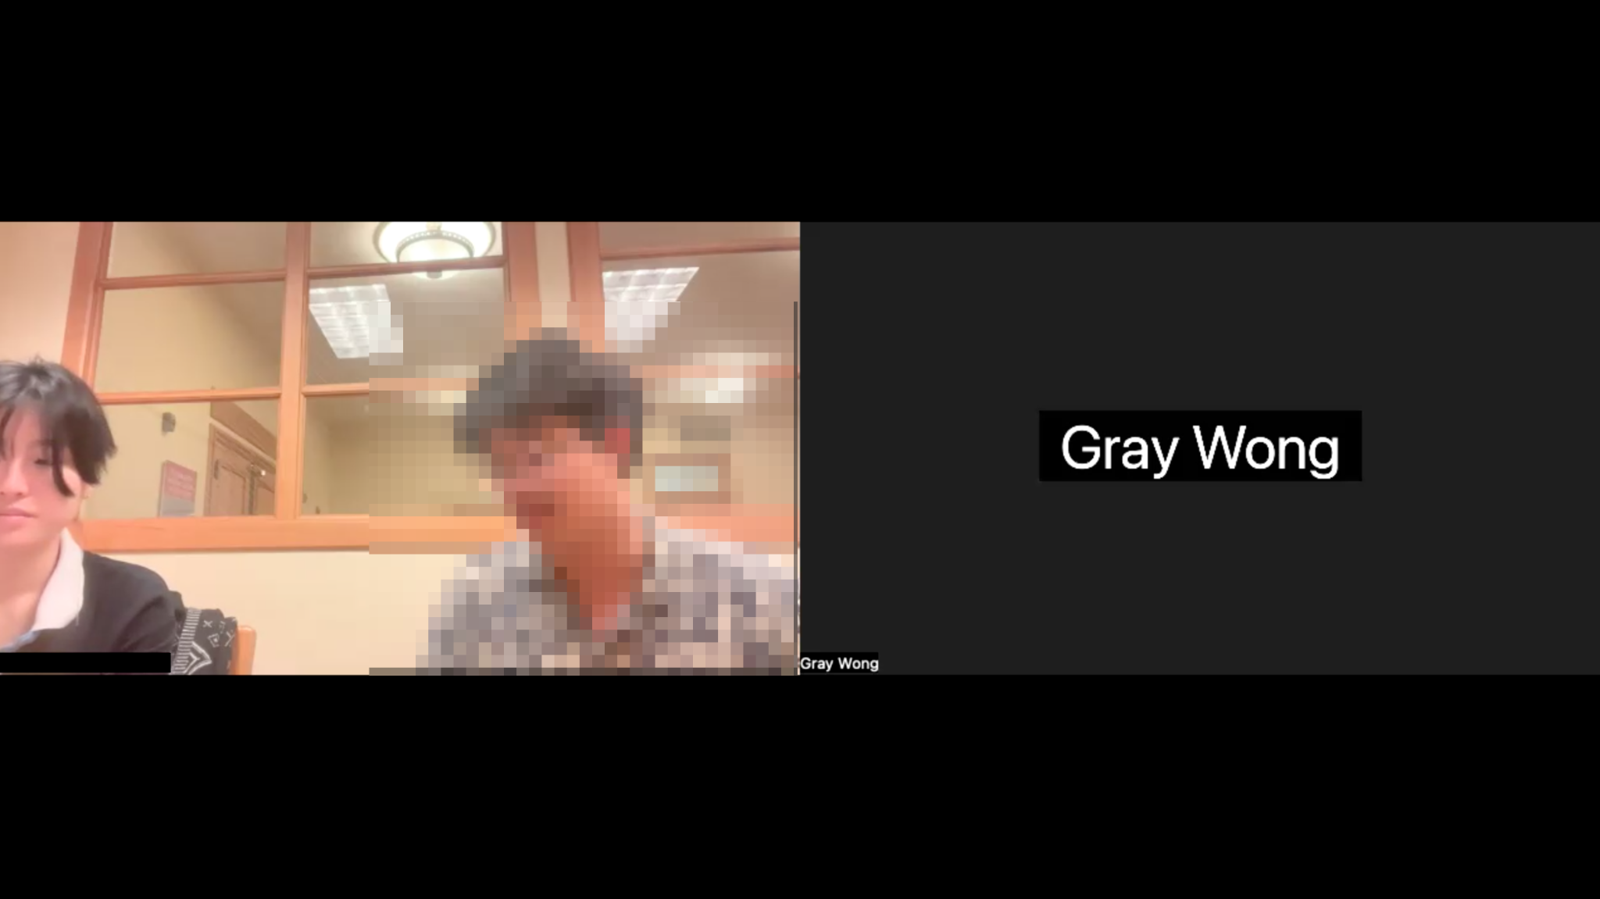


Apparatus
Tools
Apta Base https://aptabase.com
Expo Go w/ React Native
Phone (screen/audio recording)
Laptop (Zoom for video recording)
Notes:
Procedure
___ clear on what participants needed to do?
Test measures
___ appropriate variables recorded/measured?
Apparatus - describe the equipment/software you used and where tests were run Procedure - describe what you did and how
Test Measures - describe what you measured and why

Slide 20
Procedure
Procedure:
1. Introduction & Consent - Brief on study and consent for participation.
2. Task Briefing - Explain tasks to participants.
3. Task Execution - Participants perform tasks, using think-aloud protocol.
4. Feedback - Collect qualitative feedback post-task.
Notes:
Procedure
___ clear on what participants needed to do?
Test measures
___ appropriate variables recorded/measured?
Apparatus - describe the equipment/software you used and where tests were run Procedure - describe what you did and how
Test Measures - describe what you measured and why

Slide 21
Procedure
Measurements:
# clicks per task - to measure task complexity
Time per task - to measure task intuition
Qualitative feedback - to measure user satisfaction
Notes:
Procedure
___ clear on what participants needed to do?
Test measures
___ appropriate variables recorded/measured?
Apparatus - describe the equipment/software you used and where tests were run Procedure - describe what you did and how
Test Measures - describe what you measured and why

Slide 22
04.1
Results

Slide 23
User Analytics Results:
# of clicks | TASK #1: Accept | TASK #2: Discover | TASK #3: Send
Nina | 4 | 11 | 26
Lucas | 6 | 15 | 31
Karl | 5 | 5 | 38
Shelley | 1 | 1 | 19
Josh | 3 | 7 | 20
AVERAGE | 3.8 | 7.8 | 26.8
Notes:
Results: Lots of images & data including summative data & clickstream data
___ clear if participants succeeded?
___ clear on what worked and what did not, and why?
___ clear on what was learned from logged clickstream data?

Slide 24
User Analytics Results:
Amount of time
Amount of time | TASK #1: Accept | TASK #2: Discover | TASK #3: Send
Nina | 0:36 | 1:10 | 1:25
Lucas | 0:12 | 0:32 | 1:03
Karl | 0:10 | 0:22 | 3:30*
Shelley | 0:15 | 0:20 | 0:50
Josh | 0:12 | 0:30 | 1:13
AVERAGE | 0.17 | 0.35 | 1:09 (without outlier*)
*with think-aloud protocol
Notes:
Results: Lots of images & data including summative data & clickstream data
___ clear if participants succeeded?
___ clear on what worked and what did not, and why?
___ clear on what was learned from logged clickstream data?

Slide 25
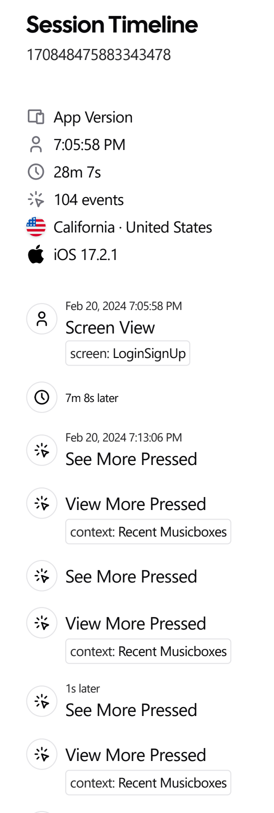
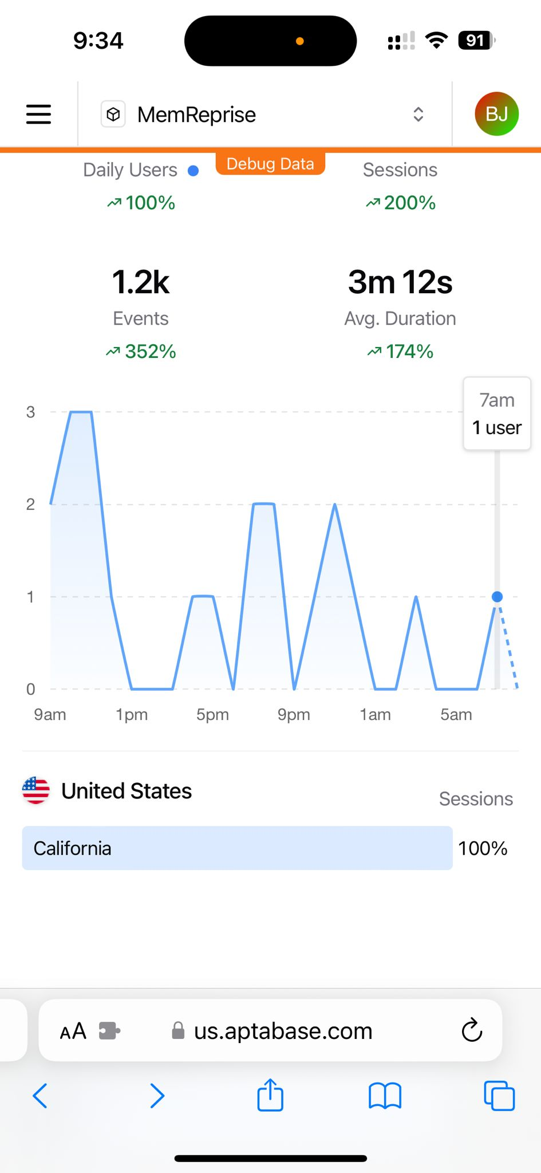
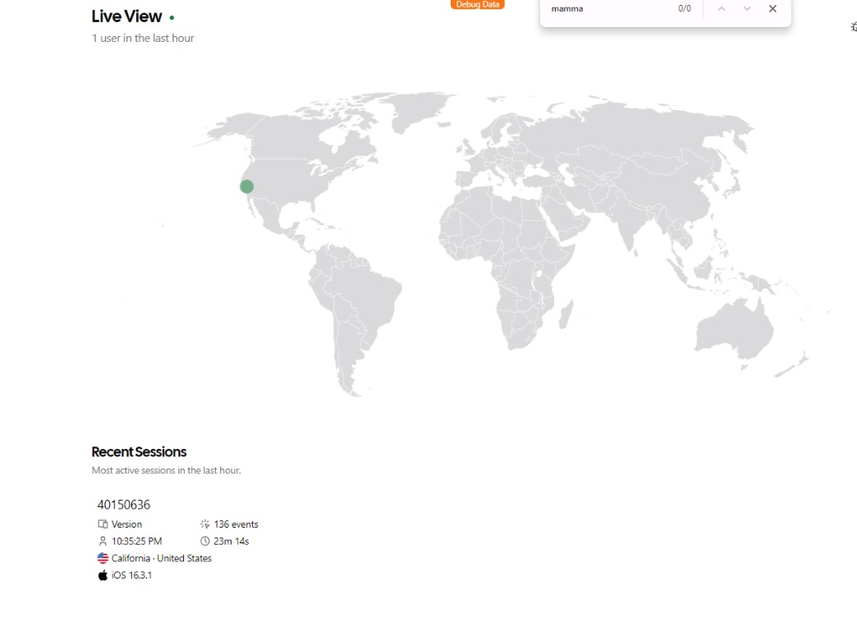
User Analytics Results:
Notes:
Results: Lots of images & data including summative data & clickstream data
___ clear if participants succeeded?
___ clear on what worked and what did not, and why?
___ clear on what was learned from logged clickstream data?

Slide 26

Results: Critical Incidents
NINA’s feedback:
(-) App should provide clear descriptions or tutorials for features like music boxes to help new users understand
(-) Enhance navigation and keyboard experience by making screens scrollable
Notes:
Discussion
What you learned from this pilot run
What you might change for the “real” experiment
What you might change in your interface from these results
Difficulties of running the experiment in situ? Any learnings particular to testing it in the wild? Did clickstream & video logging help?
Discussion
___ are recommendations for a larger study appropriate
___ are recommendations for design changes based on the results?
___ are recommendations for design changes good ideas?
___ issues / advantages of running the experiment in situ?

Slide 27
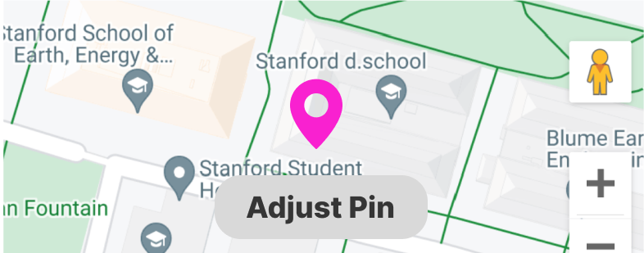
Results: Critical Incidents
LUCAS’ feedback:
(+) Sorting playlists by location is a convenient way to discover new songs for different occasions.
(-) When discovering playlists, have an interactive map with pins of where playlists are instead of having a scroll view.
Notes:
Discussion
What you learned from this pilot run
What you might change for the “real” experiment
What you might change in your interface from these results
Difficulties of running the experiment in situ? Any learnings particular to testing it in the wild? Did clickstream & video logging help?
Discussion
___ are recommendations for a larger study appropriate
___ are recommendations for design changes based on the results?
___ are recommendations for design changes good ideas?
___ issues / advantages of running the experiment in situ?

Slide 28
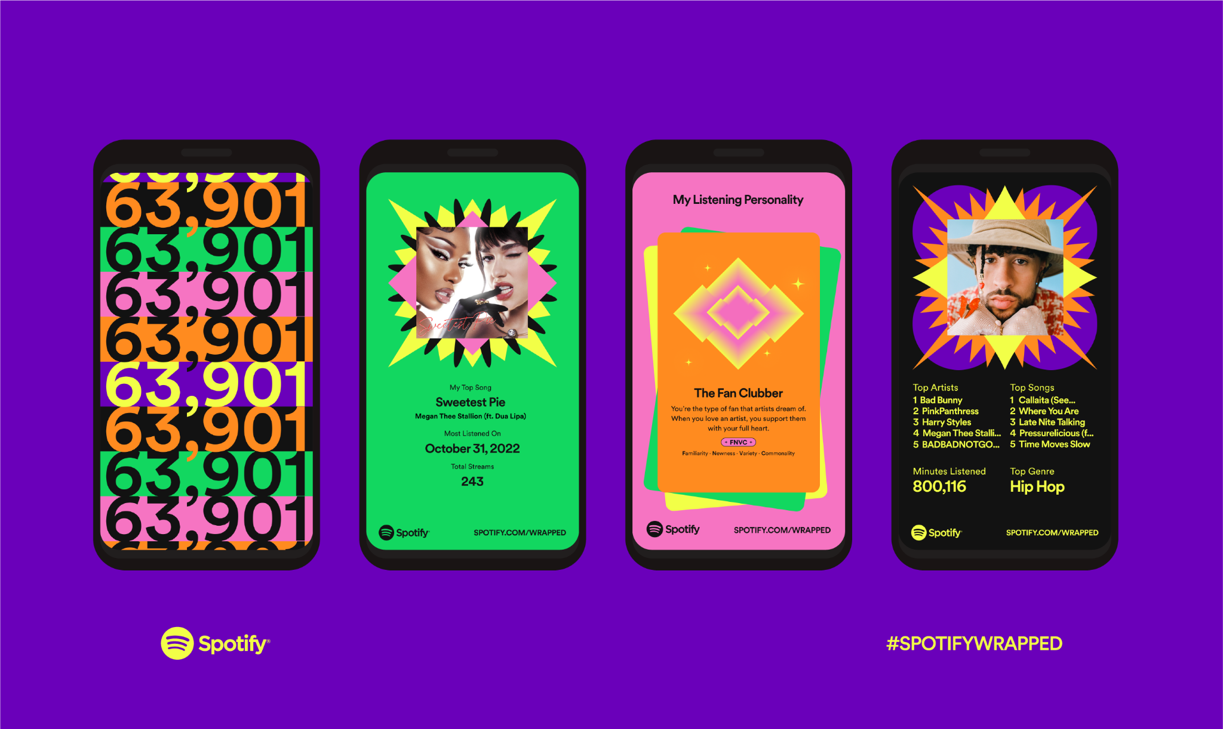
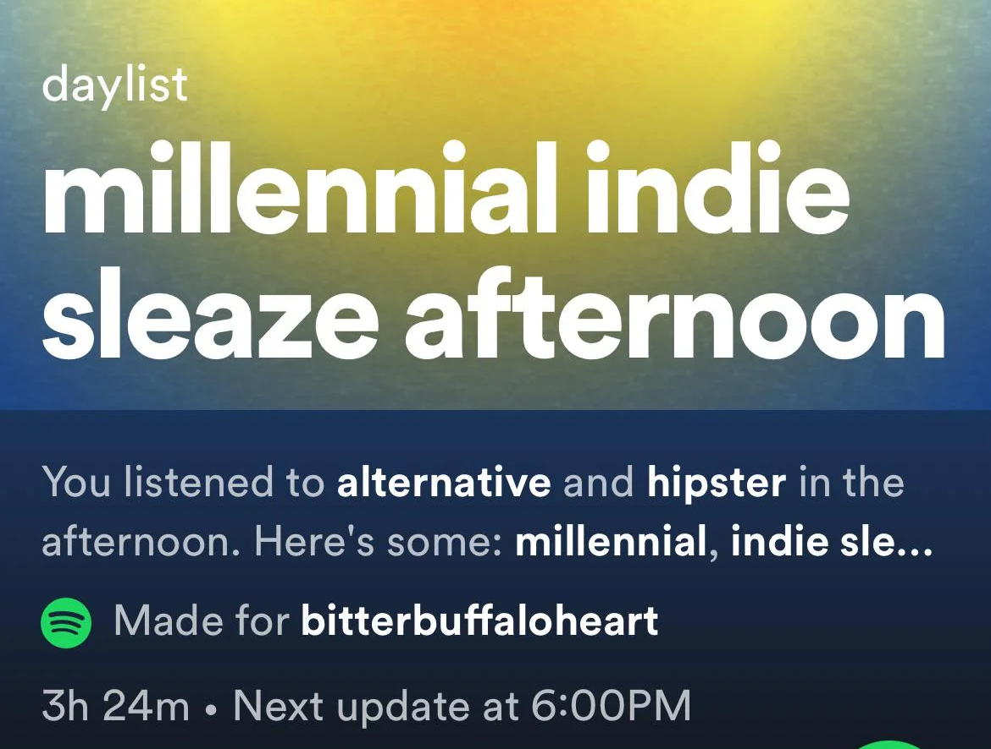
Results: Critical Incidents
KARL’S feedback
(-) No personal investment to actively engage with the app
(-) Wants a more interesting copywriting style and color scheme for clarity and engagement (like Spotify)
(-) Tabs and navigation felt unpolished
Notes:
Discussion
What you learned from this pilot run
What you might change for the “real” experiment
What you might change in your interface from these results
Difficulties of running the experiment in situ? Any learnings particular to testing it in the wild? Did clickstream & video logging help?
Discussion
___ are recommendations for a larger study appropriate
___ are recommendations for design changes based on the results?
___ are recommendations for design changes good ideas?
___ issues / advantages of running the experiment in situ?

Slide 29

Results: Critical Incidents
SHELLY’S feedback
(+) “I think it would be fun to be able to send and receive different music boxes. That's cool.”
(-) Navigation tabs was confusing due to it not being correctly labeled, making it especially difficult to send a music box.
(-) Extraneous buttons and pages that are not yet fully implemented added confusion.
Notes:
Discussion
What you learned from this pilot run
What you might change for the “real” experiment
What you might change in your interface from these results
Difficulties of running the experiment in situ? Any learnings particular to testing it in the wild? Did clickstream & video logging help?
Discussion
___ are recommendations for a larger study appropriate
___ are recommendations for design changes based on the results?
___ are recommendations for design changes good ideas?
___ issues / advantages of running the experiment in situ?

Slide 30

Results: Critical Incidents
JOSH’s feedback
(+) “I love the premise! I was just sharing a song I was listening to with a friend this morning!”
(-) Navigation bar was confusing with how the tasks were phrased - task phrasing was more clear
Notes:
Discussion
What you learned from this pilot run
What you might change for the “real” experiment
What you might change in your interface from these results
Difficulties of running the experiment in situ? Any learnings particular to testing it in the wild? Did clickstream & video logging help?
Discussion
___ are recommendations for a larger study appropriate
___ are recommendations for design changes based on the results?
___ are recommendations for design changes good ideas?
___ issues / advantages of running the experiment in situ?

Slide 31
04.2
Discussion

Slide 32
Learnings
Main takeaways:
Clearer feature guidance needed
Map interactivity would be fun and boost engagement
Navigation simplicity is key
The social element really resonated but the design could be more fun to match the vibe
Notes:
Discussion
What you learned from this pilot run
What you might change for the “real” experiment
What you might change in your interface from these results
Difficulties of running the experiment in situ? Any learnings particular to testing it in the wild? Did clickstream & video logging help?
Discussion
___ are recommendations for a larger study appropriate
___ are recommendations for design changes based on the results?
___ are recommendations for design changes good ideas?
___ issues / advantages of running the experiment in situ?

Slide 33
Action Plan
Next steps in response to learnings:
ℹ️ Add interactive feature tutorials
🗺️📍 Deploy interactive playlist maps
🏠 Simplify and clarify navigation
🎉 Increase the fun factor by introducing creative copy, groovy typography, and delightful experiences
Notes:
Discussion
What you learned from this pilot run
What you might change for the “real” experiment
What you might change in your interface from these results
Difficulties of running the experiment in situ? Any learnings particular to testing it in the wild? Did clickstream & video logging help?
Discussion
___ are recommendations for a larger study appropriate
___ are recommendations for design changes based on the results?
___ are recommendations for design changes good ideas?
___ issues / advantages of running the experiment in situ?

Slide 34
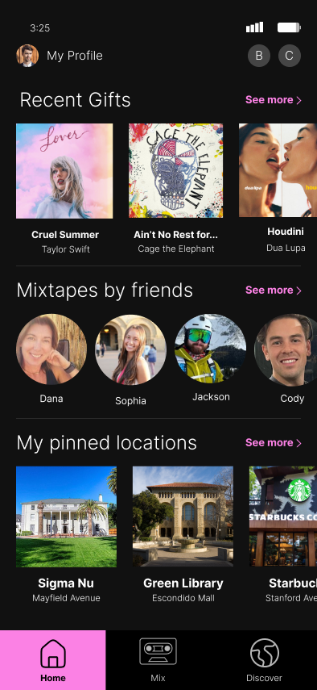
Interface Changes
🏠 Simplify and clarify navigation
Notes:
Discussion
What you learned from this pilot run
What you might change for the “real” experiment
What you might change in your interface from these results
Difficulties of running the experiment in situ? Any learnings particular to testing it in the wild? Did clickstream & video logging help?
Discussion
___ are recommendations for a larger study appropriate
___ are recommendations for design changes based on the results?
___ are recommendations for design changes good ideas?
___ issues / advantages of running the experiment in situ?

Slide 35
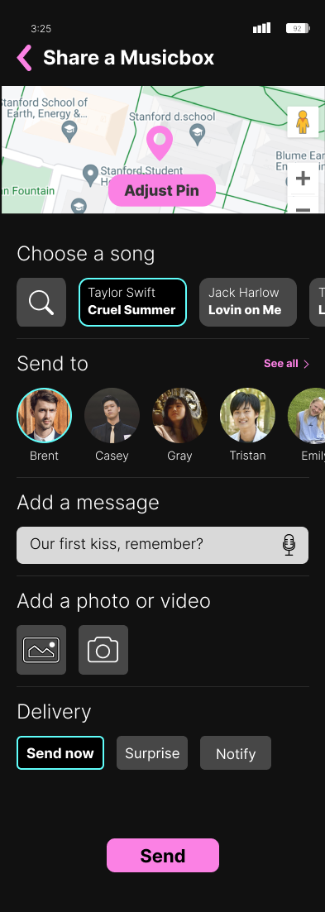

Interface Changes
🎉 Increase the fun factor
Notes:
Discussion
What you learned from this pilot run
What you might change for the “real” experiment
What you might change in your interface from these results
Difficulties of running the experiment in situ? Any learnings particular to testing it in the wild? Did clickstream & video logging help?
Discussion
___ are recommendations for a larger study appropriate
___ are recommendations for design changes based on the results?
___ are recommendations for design changes good ideas?
___ issues / advantages of running the experiment in situ?

Slide 36
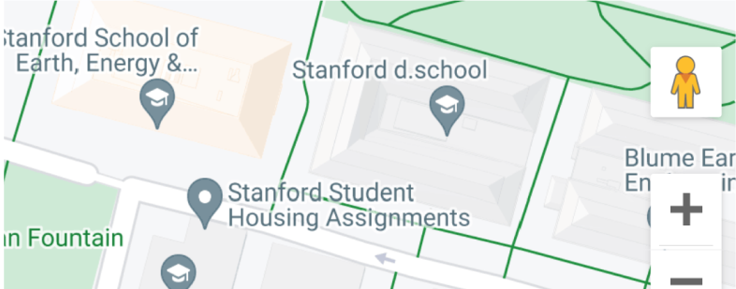
Tech Difficulties & WOZ
Receiving a geo-location-based gifts was hard to simulate - had to be simplified to adapt to range of testing locations
Playlist locations were Wizard of Oz, so fetching location-specific landmarks for playlist locations was not feasible during testing
Notes:
Discussion
What you learned from this pilot run
What you might change for the “real” experiment
What you might change in your interface from these results
Difficulties of running the experiment in situ? Any learnings particular to testing it in the wild? Did clickstream & video logging help?
Discussion
___ are recommendations for a larger study appropriate
___ are recommendations for design changes based on the results?
___ are recommendations for design changes good ideas?
___ issues / advantages of running the experiment in situ?

Slide 37
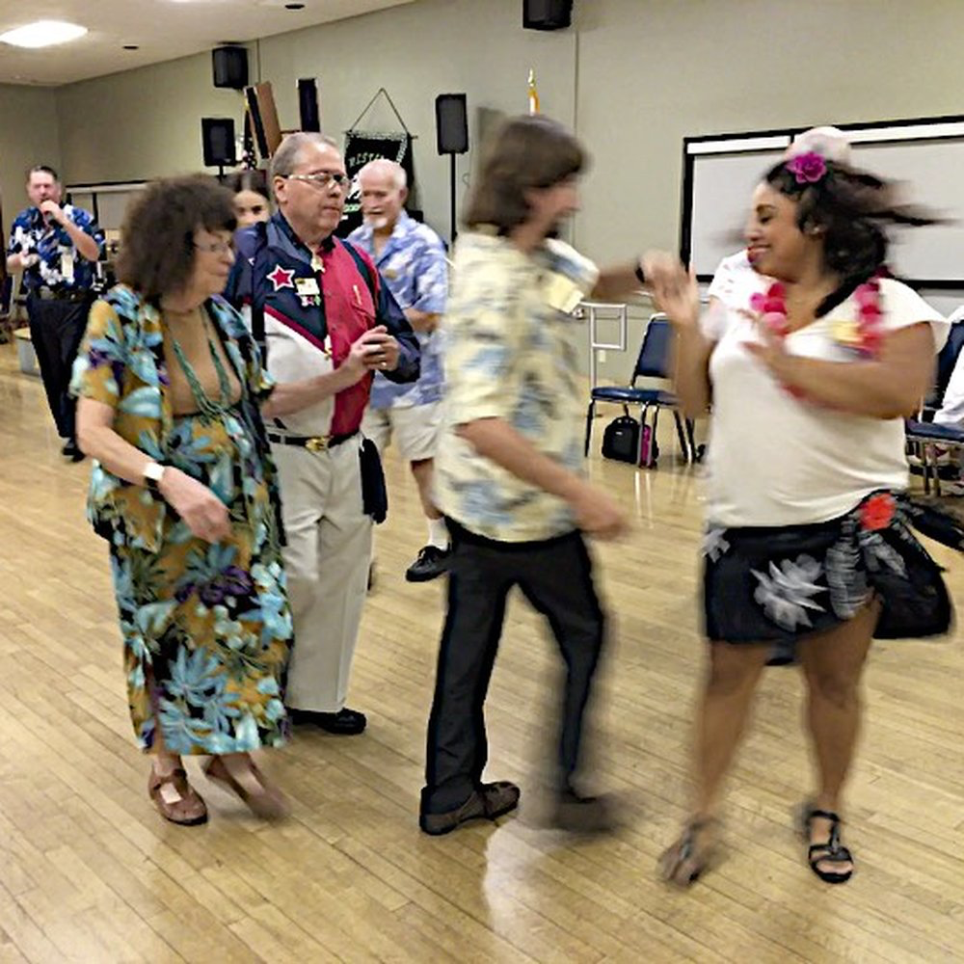

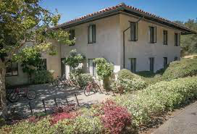
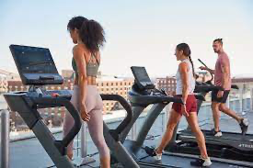
Testing in the wild
Our app can really be used anywhere, anytime - and that’s the point! (kind of like Snapchat) which makes testing in the “wild” both convenient and tricky
For our next full experiment, we’d love to do a “follow-along” study throughout our user’s day
Notes:
FOLLOW-ALONG: to see when they’d naturally pull out our app to gift a song and to fully test our location-based surprise gifting
Discussion
What you learned from this pilot run
What you might change for the “real” experiment
What you might change in your interface from these results
Difficulties of running the experiment in situ? Any learnings particular to testing it in the wild? Did clickstream & video logging help?
Discussion
___ are recommendations for a larger study appropriate
___ are recommendations for design changes based on the results?
___ are recommendations for design changes good ideas?
___ issues / advantages of running the experiment in situ?

Slide 38
thanks
any questions?

Slide 39
05
Appendix

Slide 40
